Slide 1
Summary of Proposed changes to
2012 Detroit Charter Commission
November 23, 2019
Civilian Oversight Citizen Focus Group
Presenters/Co-Chairs:
Eric Blount
(313) 837-2605
eblount265@att.net
Scotty Boman
(313) 247-2052 scottyboman@Hotmail.com

Slide 2
Research of Standards and Best Practices
Nation Association for Civilian Oversight of Law Enforcement (NACOLE) 2019 national convention in Detroit Sept.22-26, 2019
“Many have sought to develop standards or best practices to guide the work. However, given the variations among oversight agencies, their mandates, and the limited control they have over staffing and budgets, this is nearly impossible”
Notes:
Page 15 of package

Slide 3
Five Common Goals of Civilian Oversight Programs
Improving public trust
Ensuring accessible complaint processes
Promoting thorough, fair investigations
Increasing transparency
Deterring police misconduct
Notes:
*Based on data collected from 97 civilian oversight programs

Slide 4
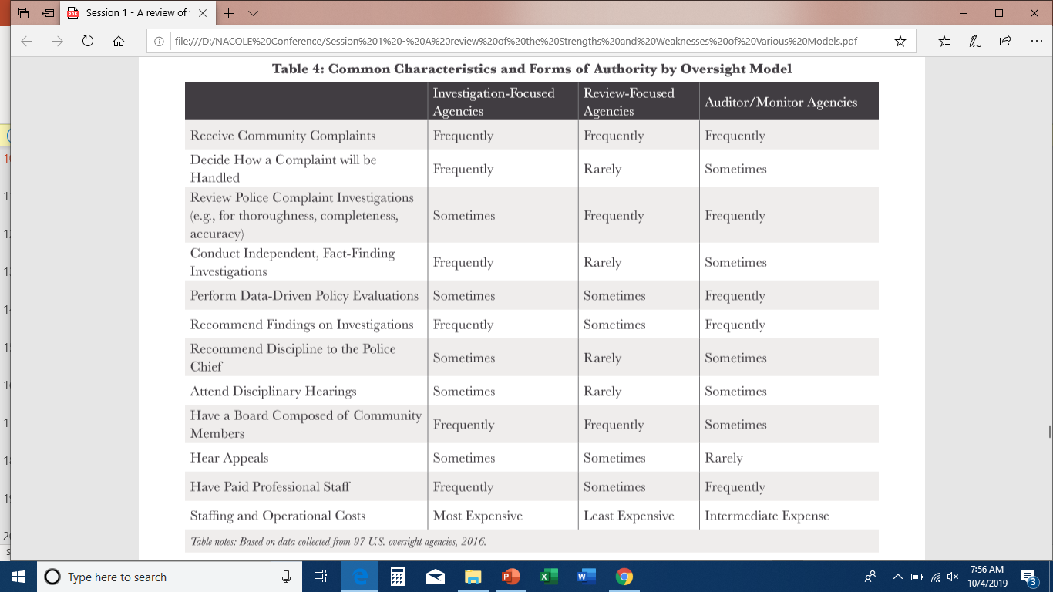

Slide 5
Improving public trust
All Commissioners must be elected
Copy City Council (7-2)
Vacancies
(Amend Sections 3-105, 3-107, 3-109, 7-802 for this purpose).
Mitigate conflicts of interest
Notes:
*Based on data collected from 97 civilian oversight programs

Slide 6
Improving public trust
All Commissioners must be elected
Copy City Council (7-2)
Vacancies filled by runners up who shadow the winner.
(Amend Sections 3-105, 3-107, 3-109, 7-802 for this purpose).
Commissioners can’t be former DPD officers.
Notes:
*Based on data collected from 97 civilian oversight programs

Slide 7

Why is this important
Current Charter
11 Commissioners (7-4) with options to appoint more/all
Elected - Appointed Appointments Allowed

Slide 8
Ensuring accessible complaint
Separate Building
Tracking
Reporting
Follow-up
Notes:
*Based on data collected from 97 civilian oversight programs

Slide 9
Promoting thorough, fair investigations
Require a shorter reporting time by the Chief Investigator, or have the Chief Investigator report the need for time-sensitive subpoena at the next board meeting. (Section 7-808)
Complaints must be resolved (and the outcome reported to the complainant) within 30 days.(Section 7-808)

Slide 10
Promoting thorough, fair investigations
(continued)
All city-possessed video and body-cam video shall be made accessible to the Board of Police Commissioners by the subsequent meeting (within 5 business days). (Section 7-808)
All police shootings, and any allegation of police use of force (beyond the existence of an arrest), shall be investigated by the Board of Police Commissioners. (7-803 & 7-808).

Slide 11
Increasing transparency
The Chief of Police shall hold no other office. (7-805)
Have the Board of Police Commissioners choose the Police Chief (Section 7-805)
Require that commissioners make minutes of all committee meetings and closed sessions available to all other commissioners and that all minutes be made available to the general public. Identifying and personal information may be redacted unless the involved person approves the release of the information. (section 7-803)

Slide 12
Increasing transparency
(continued)
Have qualified citizens shadow the commissioners for one year. (Section 7-804)
Require police officers to live in Detroit as a condition of employment. (Section 7-812)
Add a third staff category: Member Staff. Each board member shall have a part-time staff member to help the member address constituent concerns and assist the member in the performance of his or her duties. (Section 7-804)

Slide 13
Deterring police misconduct
Permit the BOPC to establish policies, rules and regulations without Mayoral consent. (Section 7-803)
Each commissioner shall have a budget and a dedicated office space (room or cubicle) in which to meet with constituents and securely store documents. The office space shall be equipped with a networked computer. (7-802)

Slide 14
End SYSTEMIC
PROTECTIONS
OF police misconduct
Add to Article 7, Chapter 8 of the charter as section 7-819: "All contracts entered into by the Detroit Police Department must have the clause, 'Nothing here-in shall be construed to permit violations of the Detroit City Charter, and any language here-in that violates the Detroit City Charter shall be void.' Any contracts between the Detroit Police Department and contractors, labor unions, or other parties, that omits this clause, shall be void.”

Slide 15
End THE USE OF POTENTIALLY LETHAL RESTRAINTS FOR NON-DEFENSIVE PURPOSES
Add to Section 7-807 Discipline: "Police may only engage in the following actions for protection of themselves or the public, under circumstances identical to those under which any civilian would also be permitted to do so, with the same burden of proof requirements: Holds or means of restraint that impair respiration including choke holds, sustained chest compression, or compressing blood vessels in a manner that prevents oxygen from reaching the brain. Punching with a closed fist in a manner that is likely to cause injury. Violation of this policy will be grounds for dismissal, and the Detroit Police Department will advise the courts to treat the officer involved with the same due process and standards as would be applied to a civilian acting in a similar manner

Slide 16
Comparison of Some Oversight Boards
City | Baltimore | Detroit | Los Angeles | New York
Elected | 0 | 7 | 0 | 0
Appointed | 9 | 4 | 5 | 13
Others | 4 | 0 | 0 | 0
Meetings | monthly | weekly | weekly | monthly
District | yes | yes | No | yes
Mediation | yes | no | no | yes
Salary | no | no | no | no
Former police allowed | yes | yes | yes | no

Slide 17
The Process Continues
It is our consensus that these changes would be an improvement.
We are still receiving suggestions for revisions we may act on.
We may suggest other revisions in response to lawyers, commissioners or city departments
Notes:
*Based on data collected from 97 civilian oversight programs

